Slide 1



Causal Python
PyCon Israel 2021
Dr. Hanan Shteingart

Slide 2
Summary
Data + Assumptions
Causal Inference
Better Decisions

Slide 3
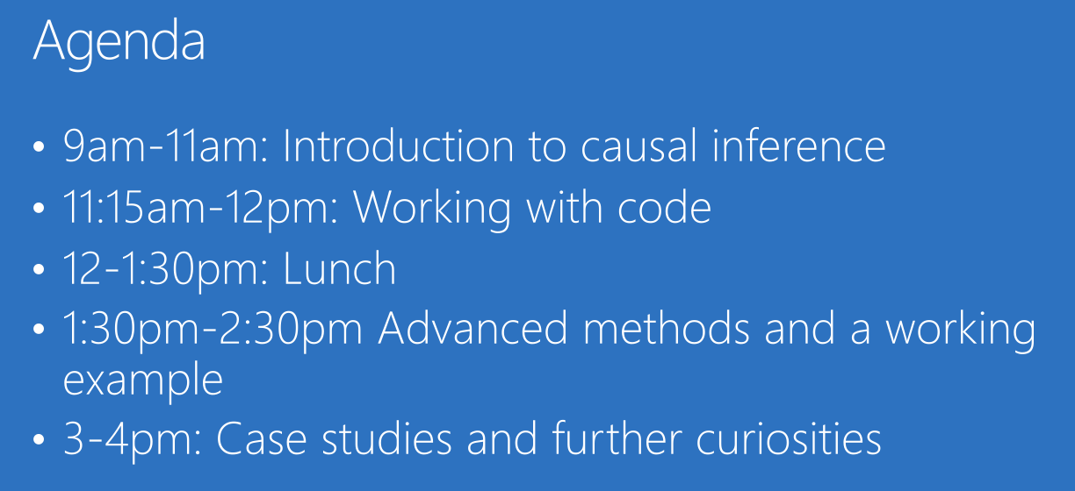

Misson Impossible
A typical causal workshop… PyCon 2021
45 min!
https://github.com/amit-sharma/causal-inference-tutorial

Slide 4
Agenda
Motivation
Theory
Practise

Slide 5

Motivation
The need to go beyond predictions

Slide 6


Most Important Business Question?
What ACTIONS should I take to maximize my KPIs?
ACTIONs business interventions
KPI(s) outcome(s) you care about.

Slide 7
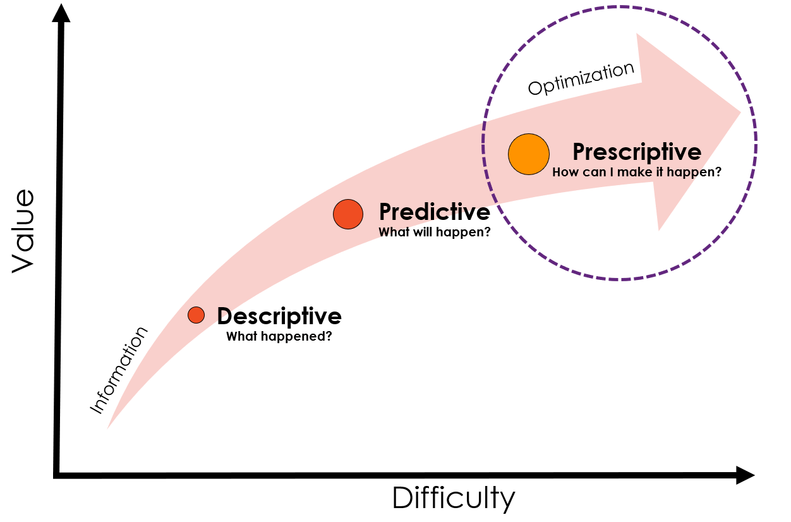


Three Layers of Analytics
There are three types of analytic questions
What business need is better decisions (not better predictions)
“There is a gap between making a prediction and making a decision” - S. Athey 2017, Science.
Griffin, D. K. (2020).
Athey, S. (2017).
Bertsimas, D., & Kallus, N. (2020).

Slide 8

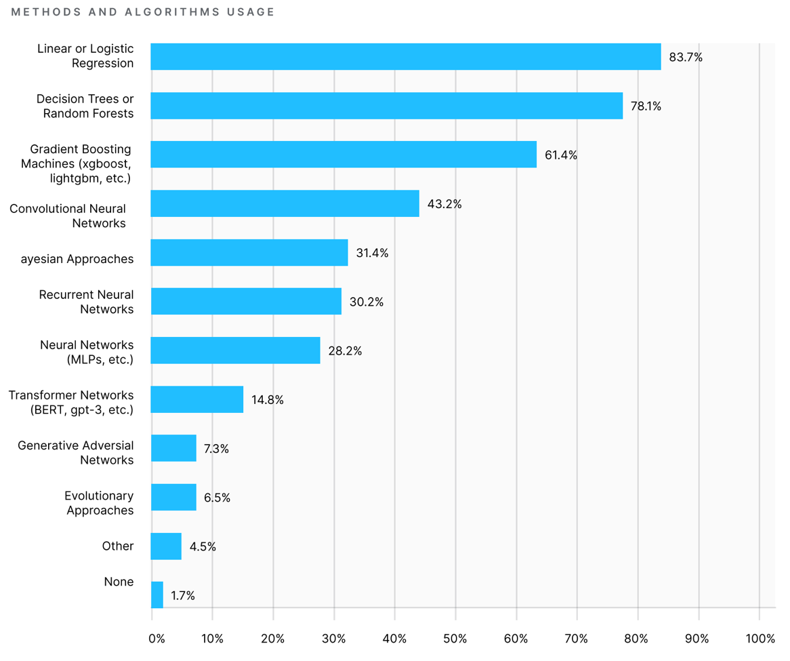
Prescriptive is Neglected
Prescriptive methods seem to be neglected
What is the effect of doing an action A?
What is the optimal policy π to maximize the KPI(s)?
https://www.kaggle.com/kaggle-survey-2020

Slide 9

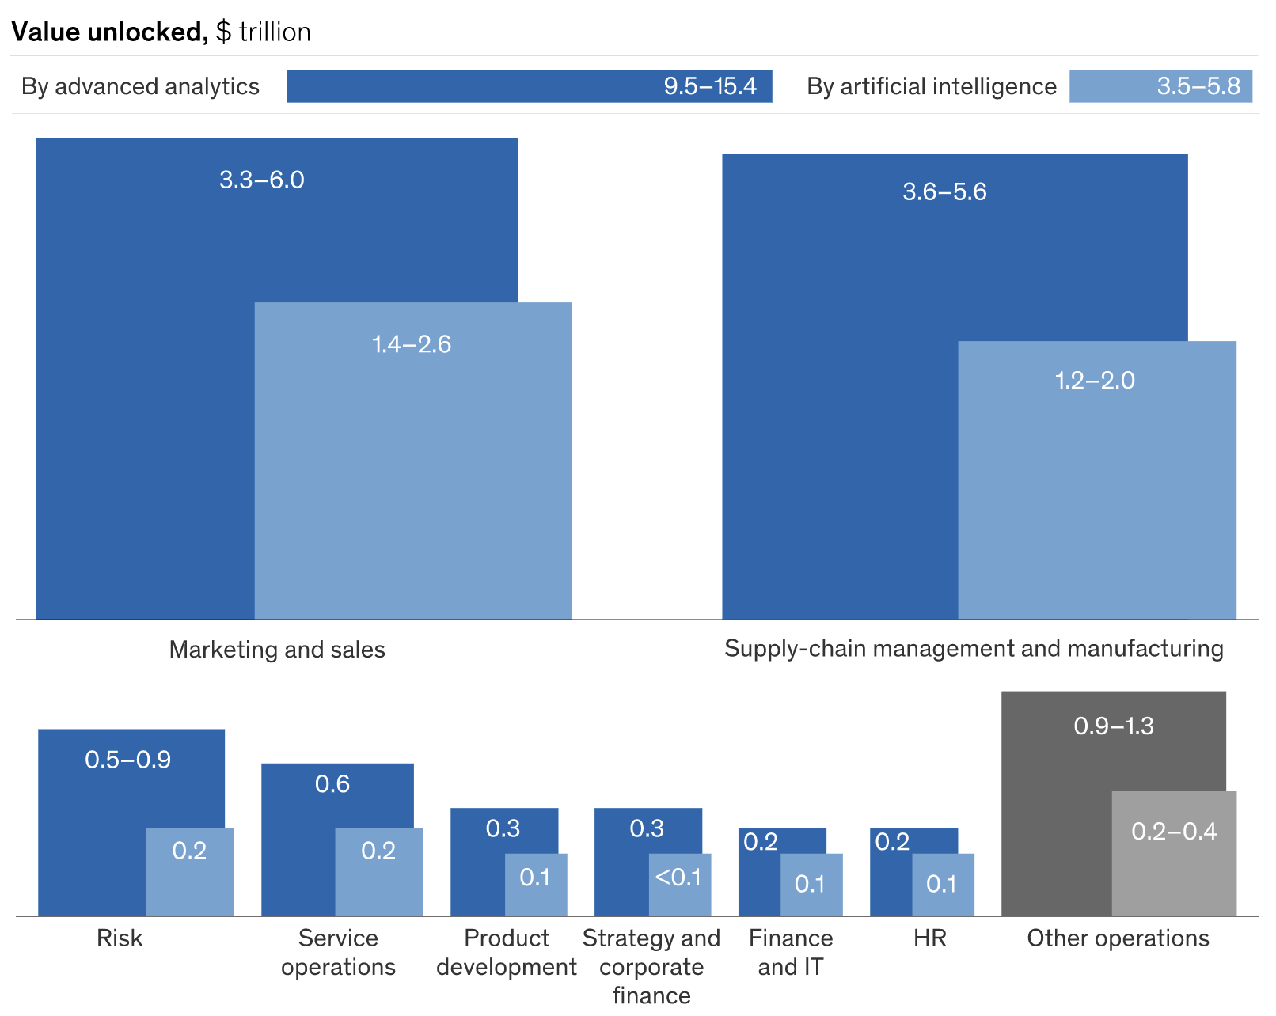
Most $$$ in AI will be in 2 areas!
Two main target markets:
Marketing & Sales
Supply-chain management and manufacturing
What’s common?
Increase some KPI – 𝑅
by doing some actions – 𝐴
In some context - 𝑆
Under some constraints - 𝐶
Causal Inference and Reinforcement Learning!
https://www.mckinsey.com/business-functions/mckinsey-analytics/our-insights/most-of-ais-business-uses-will-be-in-two-areas

Slide 10
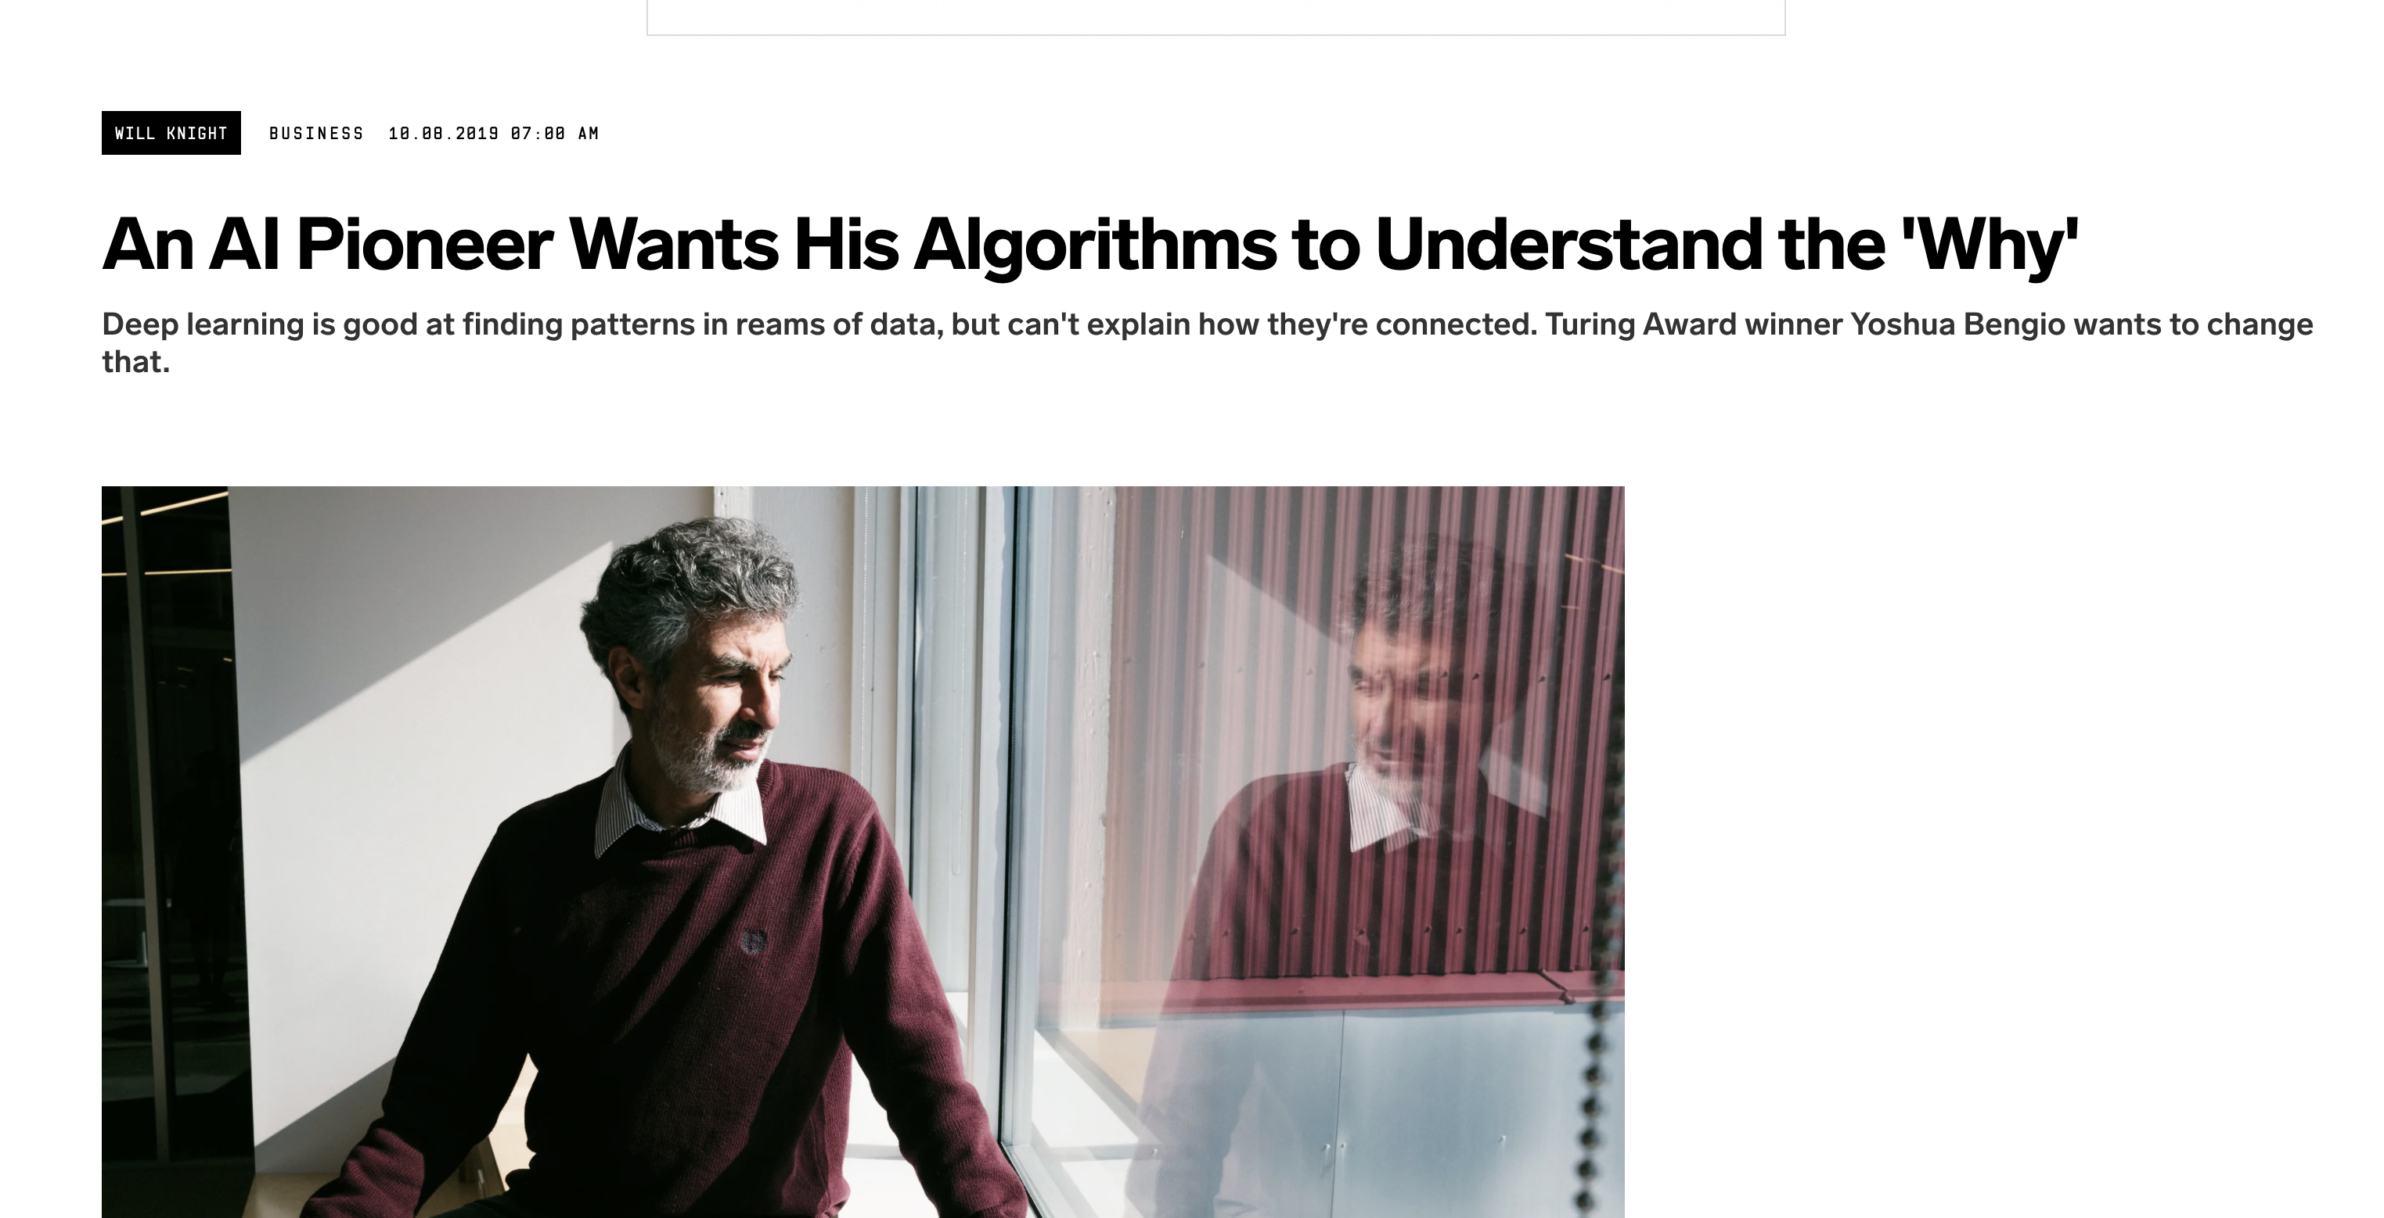
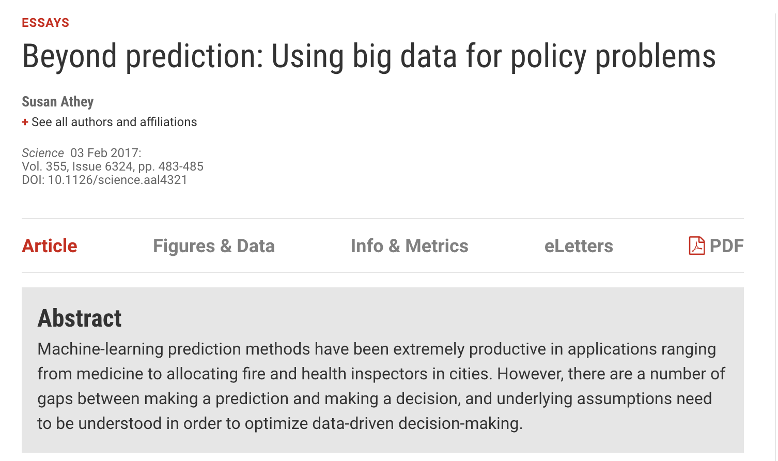
Don’t believe me

Slide 11
Don’t believe me 2
"causal inference helps us provide a better user experience for customers on the Uber platform"
"we rely on quasi-experiments and causal inference methods, especially to measure new marketing and advertising ideas."
"we analyze marketing campaigns and the impact of app preloads using a fourth type of observational study format."
"figuring out whether booking an attraction ticket increases long term user engagement"
"Leveraging a market-level approach to measure landing page effectiveness on Airbnb" (Difference in difference)
Notes:
Linkedin - https://hdsr.mitpress.mit.edu/pub/wjhth9tr/release/1
Netflix - https://netflixtechblog.com/reimagining-experimentation-analysis-at-netflix-71356393af21
Google – Optimize - https://www.blog.google/products/marketingplatform/analytics/new-ways-manage-and-measure-your-experiments-google-optimize/
Google – research CausalImpact - https://google.github.io/CausalImpact/CausalImpact.html, Alex D'amour https://research.google/pubs/pub47884/
AirBnb - https://medium.com/airbnb-engineering/experimentation-measurement-for-search-engine-optimization-b64136629760
Booking - https://booking.ai/pydata-amsterdam-2019-at-booking-com-198c2d3ae34a
Uber - https://eng.uber.com/causal-inference-at-uber

Slide 12

Theory
Causal Inference 101

Slide 13
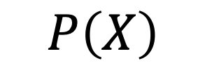
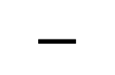

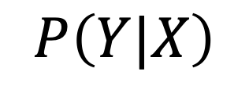
Summary
$$P\left(Y|X, do T\right)$$
$$P\left(Y|X\right)$$
$$P\left(X\right)$$
$$−$$

Slide 14
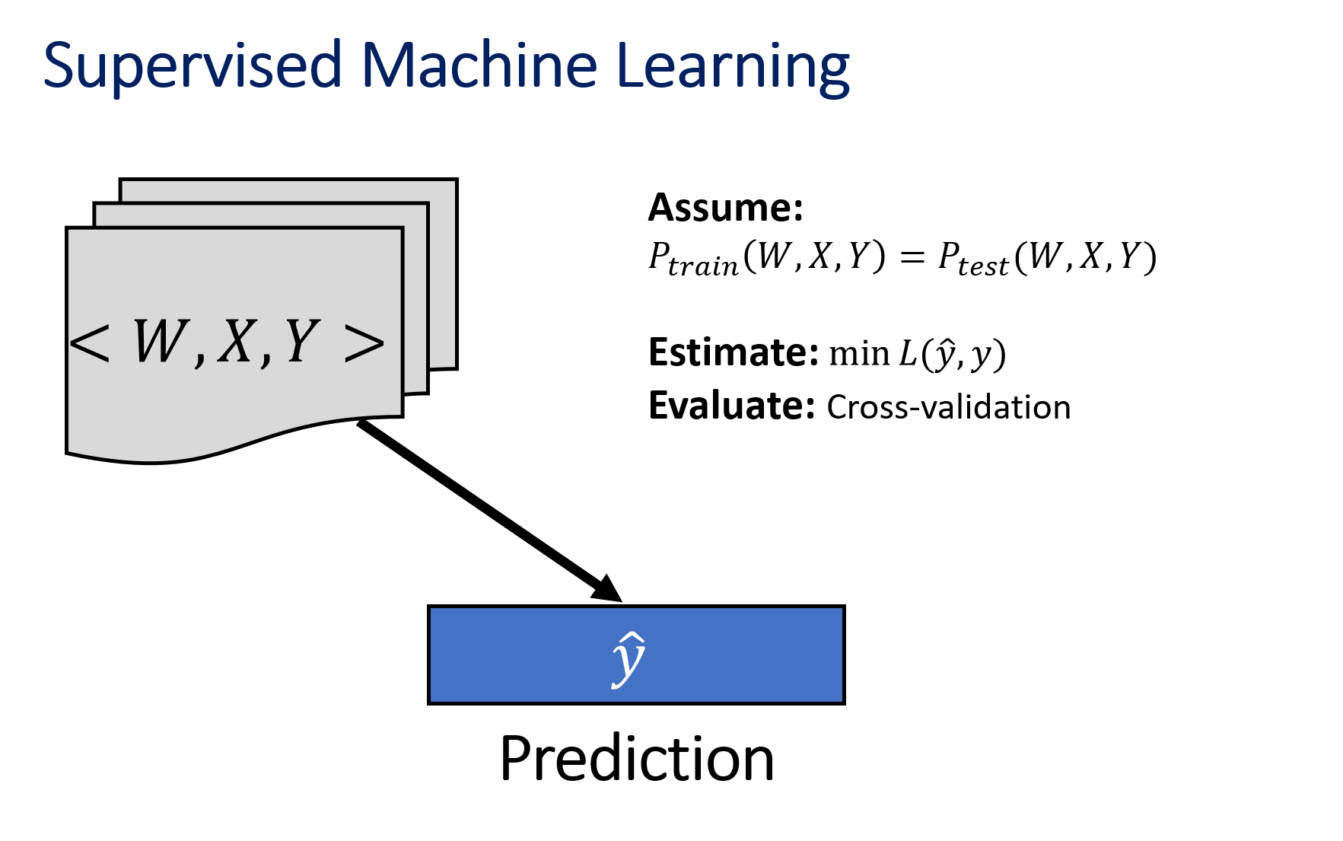
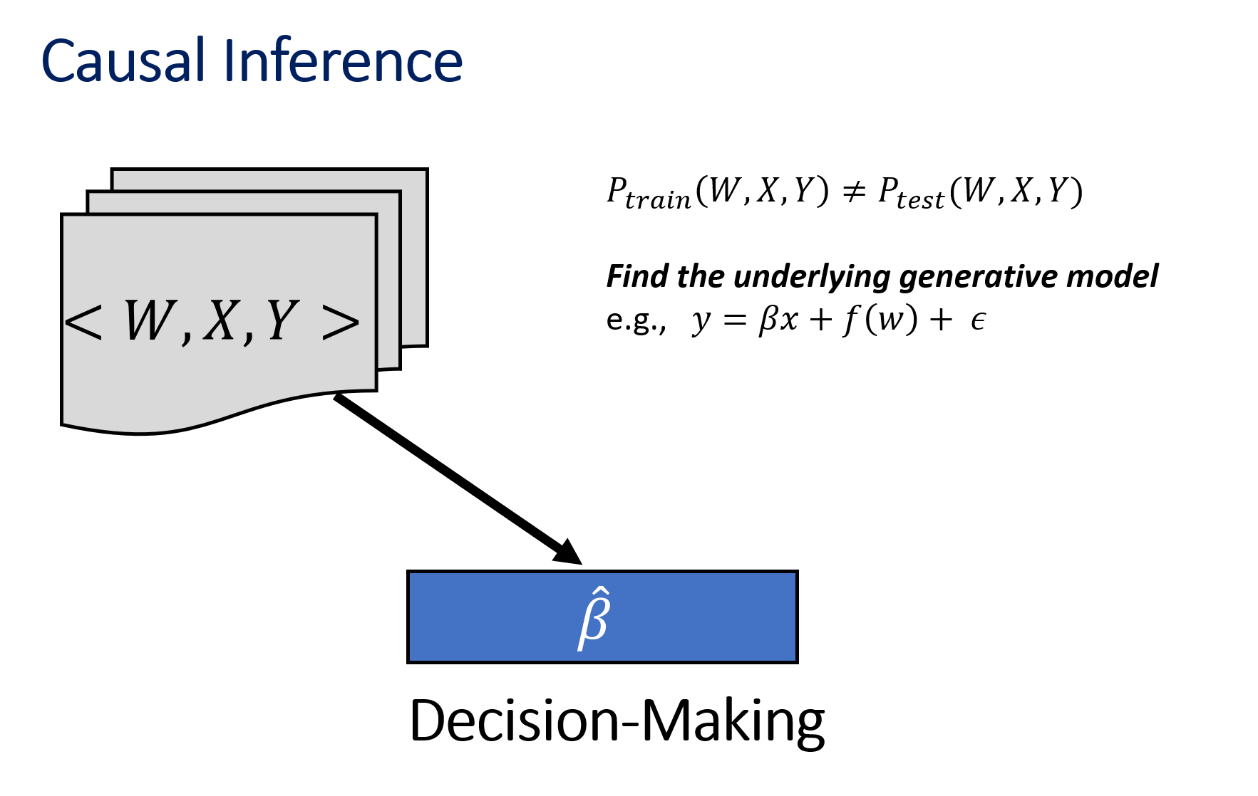
Why is Causal Infernece Different then Supervised Learning?

Slide 15
Causal Inference Main Concepts
Direceted Acyclic Causal Graph (DACG) – truth about what causes what
Causal Discovery Find the causal dependce given a dataset (otherwise you need an expert) $$T→Y$$
Causal Discovery Find the causal dependce given a dataset (otherwise you need an expert) 𝑇→𝑌
Potential Outcomes What would had happened if (only) the treatment was set to $T$ $Y^{t}=Y do T=t$
Potential Outcomes What would had happened if (only) the treatment was set to 𝑇 𝑌^𝑡=𝑌 𝑑𝑜 𝑇=𝑡
Causal Inference Find the average treatment effect (ATE): $$τ_{ATE}= E(Y^{1})−E(Y^{0})$$
Causal Inference Find the average treatment effect (ATE): 𝜏_𝐴𝑇𝐸= 𝐸(𝑌^1)−𝐸(𝑌^0)
CATE/ITE/THE
What is the effect per unit? $$τ_{ITE}(X)= E\left(Y^{1} | X \right)−E(Y^{0}|X)$$
CATE/ITE/THE
What is the effect per unit? 𝜏_ITE (X)= 𝐸(𝑌^1│𝑋 )−𝐸(𝑌^0 |𝑋)
Policy Evaluation
What is the value of policy $π\left(X\right)=\operatorname{Pr}\left(T | X\right)$? $$PE=E_{T\sim π\left(X\right)}(Y)$$
Policy Evaluation
What is the value of policy 𝜋(𝑋)=Pr⁡(𝑇│𝑋)? PE=𝐸_(𝑇~𝜋(𝑋) ) (𝑌)
Policy Optimization What is the best policy? $$PO=\underset{π}{argmax}{E_{T\sim π\left(X\right)}(Y) }$$
Policy Optimization What is the best policy? PO=argmax┬𝜋⁡〖𝐸_(𝑇~𝜋(𝑋) ) (𝑌)" " 〗

Slide 16

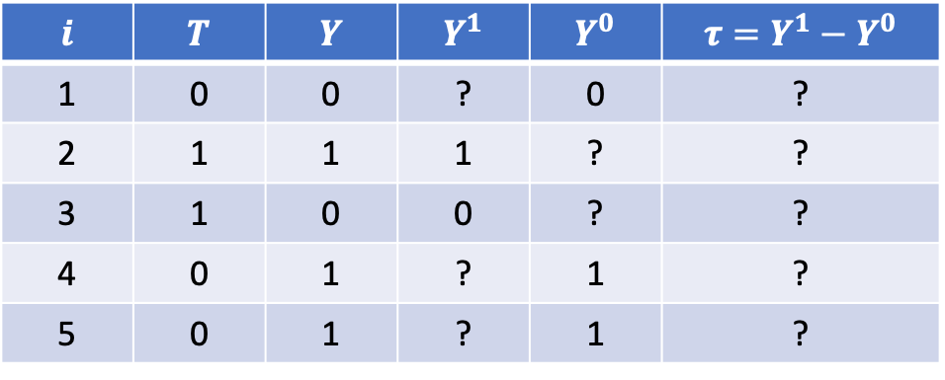
What is the Fundumental Problem?
Counterfactual is a missing data problem
Play make belief with potential outcomes
treatment
outcome
potential outcomes
Individual treatment effect
$$i$$ | $$T$$ | $$Y$$ | $$Y^{1}$$ | $$Y^{0}$$ | $$τ=Y^{1}−Y^{0}$$
1 | 0 | 0 | ? | 0 | ?
2 | 1 | 1 | 1 | ? | ?
3 | 1 | 0 | 0 | ? | ?
4 | 0 | 1 | ? | 1 | ?
5 | 0 | 1 | ? | 1 | ?
https://www.bradyneal.com/causal-inference-course

Slide 17
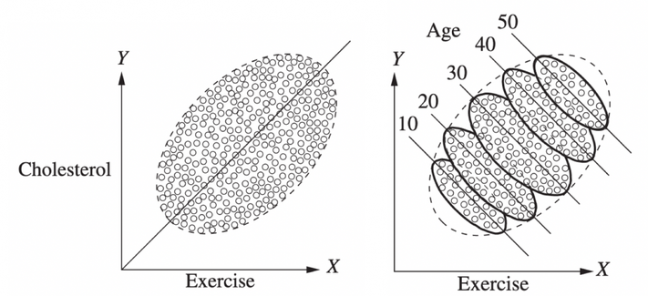
Quiz
Exercise is known to reduce Cholesterol level
You collected a medical dataset and plotted these variables against each other
What can explain this?

Slide 18
Confounders Create Bias in Effect Estimation
Age is a confounder which effects both the treatment (Exercise) and the outcome (Cholesterol)
This creates a bias!
X
T
Y
X
Y
T
https://towardsdatascience.com/implementing-causal-inference-a-key-step-towards-agi-de2cde8ea599

Slide 19
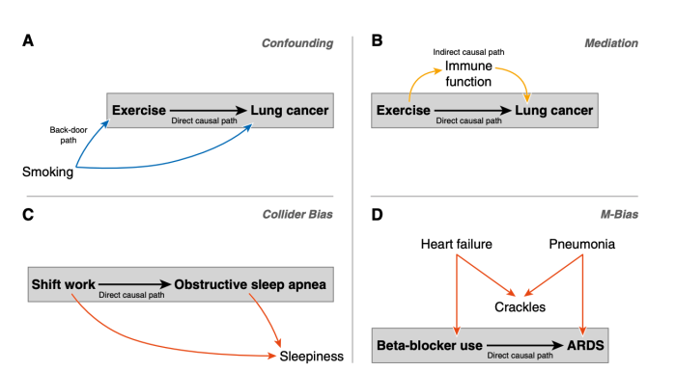
Beyond Confounders
Red lines should not be accounted for.
Lederer et al., 2019

Slide 20
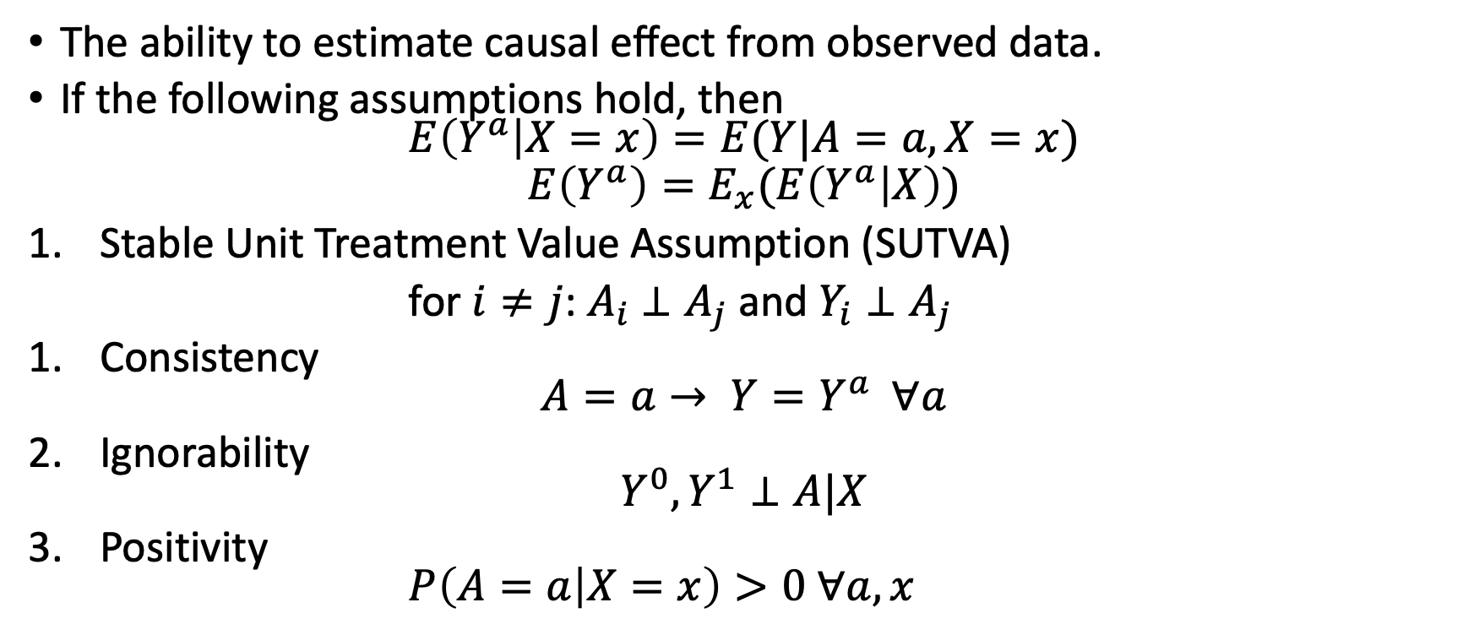
Identifiability
The ability to estimate causal effect from observed data.
If the following assumptions hold, then $E\left(Y^{a} | X=x\right)=E(Y|A=a,X=x)$
$$E\left(Y^{a}\right)=E_{x}(E\left(Y^{a} | X\right))$$
Stable Unit Treatment Value Assumption (SUTVA)
for $i≠j$: $A_{i}$ $⊥A_{j}$ and $Y_{i}⊥A_{j}$
Consistency $A=a→ Y=Y^{a} ∀a$
Ignorability $Y^{0}, Y^{1}⊥A|X$
Positivity $P\left(A=a | X=x\right)>0 ∀a,x$
Not to be confused with the law of total expectation

Slide 21
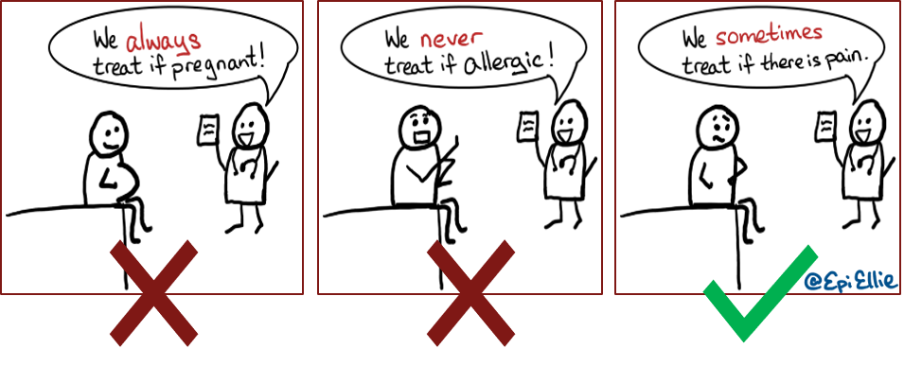
Quiz: which assumption is this?

Slide 22
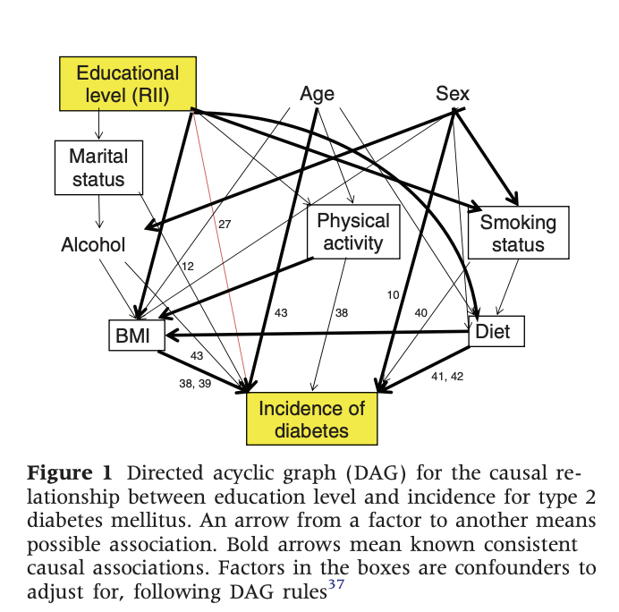

What to control for (what is $X$)?
When the causal DAG is complicated Do- calculus (Pearl) helps to do identification
Input: DAG + Data
Output: identification (a recipe of how to estimate the effect)
Sacerdote, et al International journal of epidemiology 2012

Slide 23
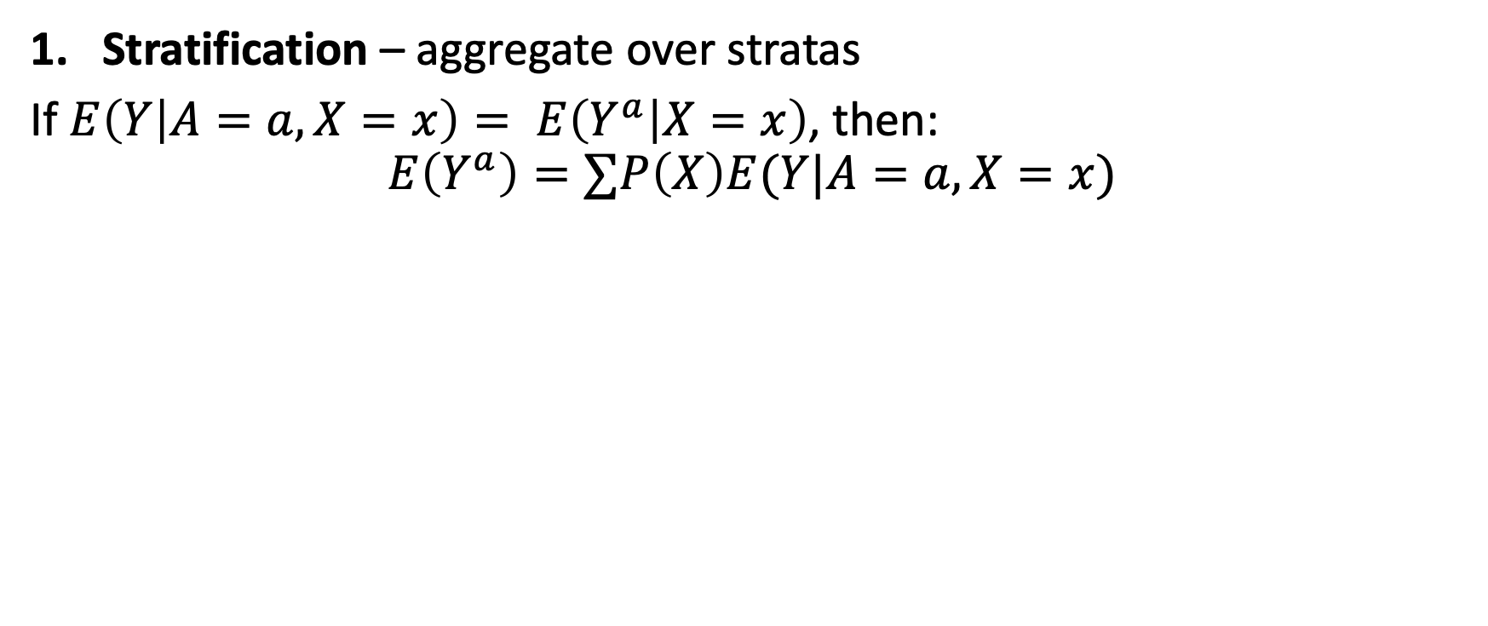
Estimation Methods
Stratification – aggregate over stratas
If $E\left(Y | A=a,X=x\right)= E\left(Y^{a} | X=x\right)$, then:
$$E\left(Y^{a}\right)=∑P\left(X\right)E(Y|A=a, X=x)$$

Slide 24
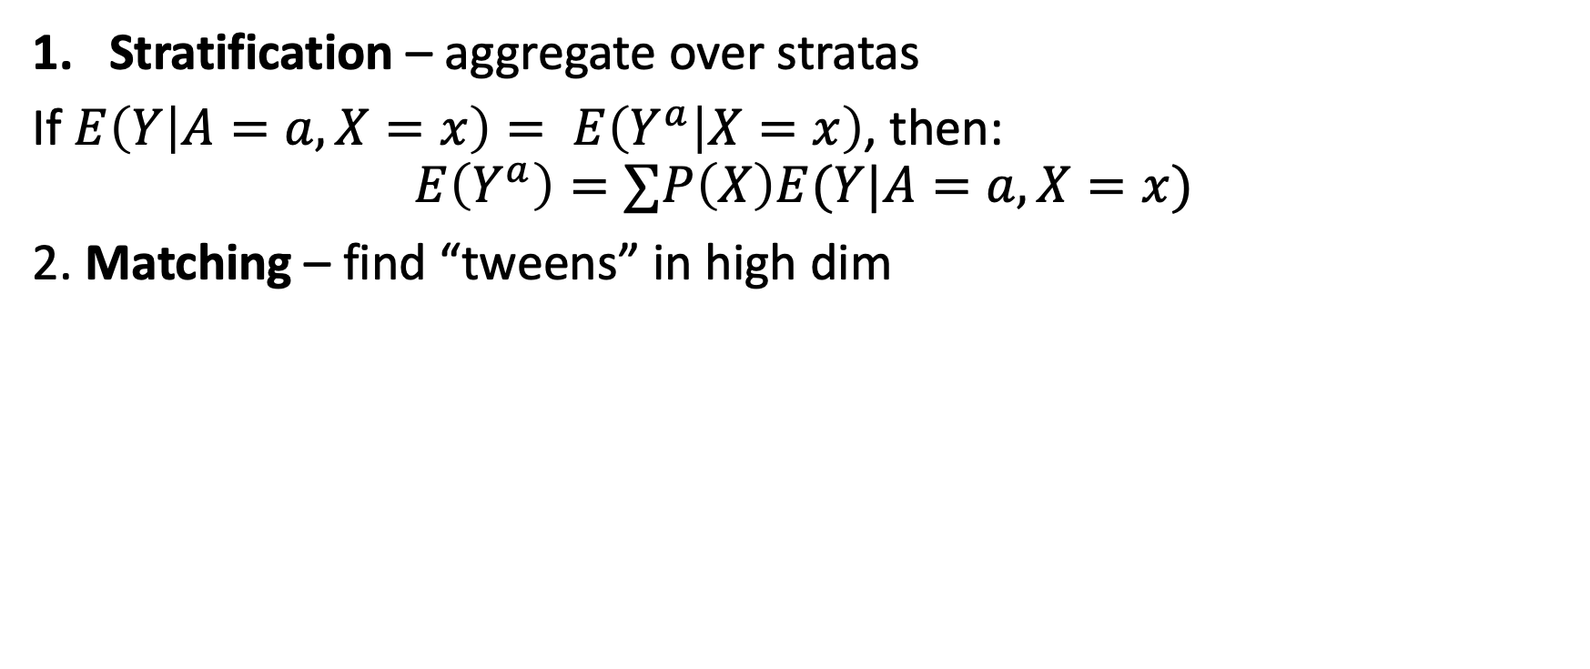
Estimation Methods
Stratification – aggregate over stratas
If $E\left(Y | A=a,X=x\right)= E\left(Y^{a} | X=x\right)$, then:
$$E\left(Y^{a}\right)=∑P\left(X\right)E(Y|A=a, X=x)$$
2. Matching – find “tweens” in high dim

Slide 25
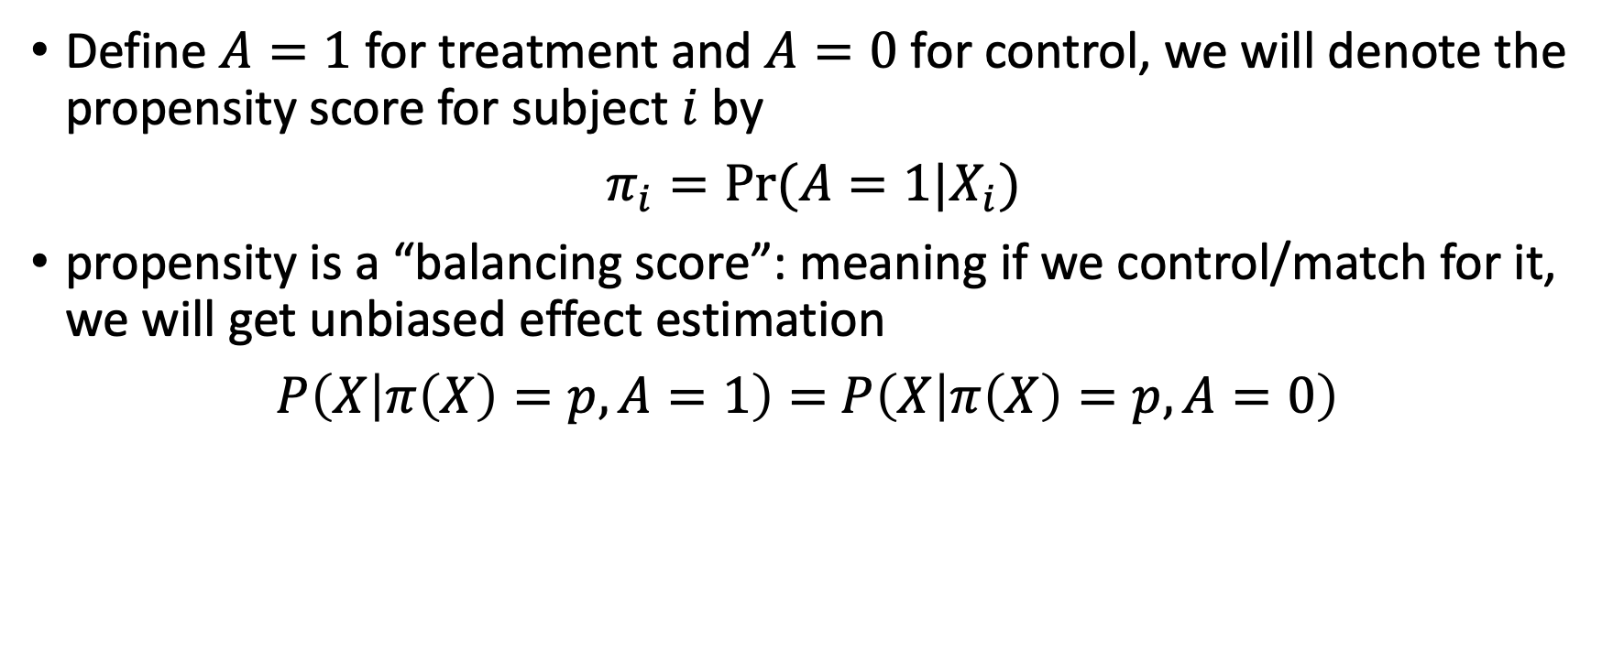
Propensity Score
Define $A=1$for treatment and $A=0$ for control, we will denote the propensity score for subject $i$ by
$π_{i}=Pr⁡(A=1|X_{i})$
propensity is a “balancing score”: meaning if we control/match for it, we will get unbiased effect estimation
$P\left(X | π\left(X\right)=p, A=1\right)=$ $P\left(X | π\left(X\right)=p, A=0\right)$

Slide 26
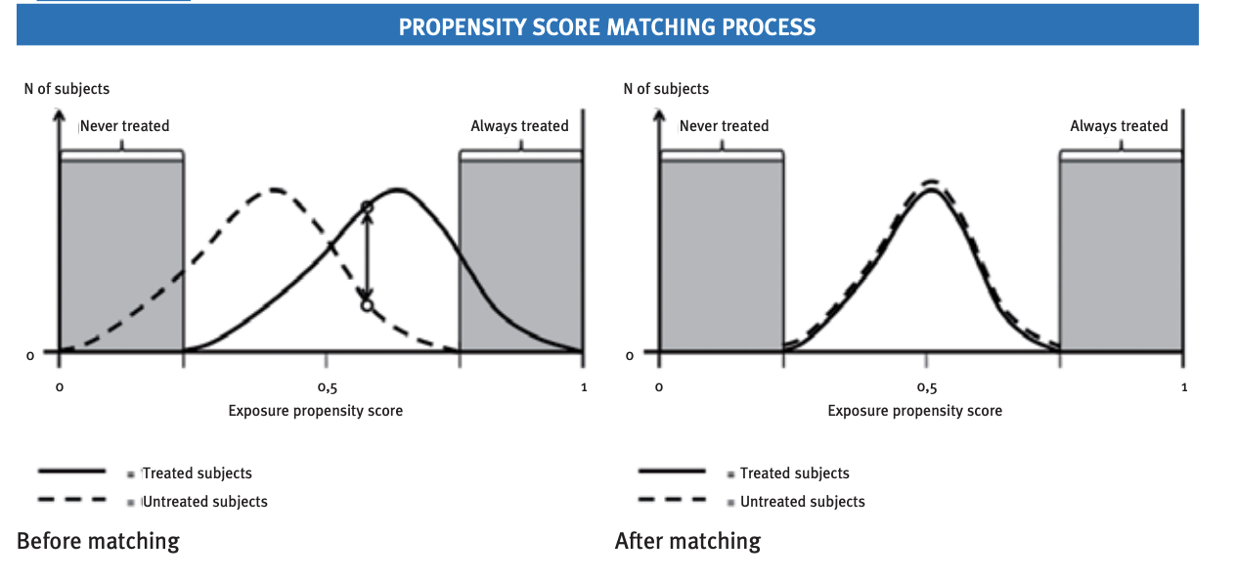
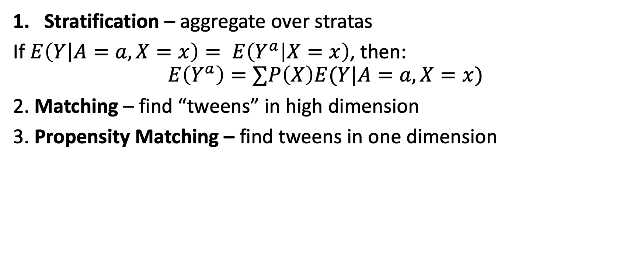
Estimation Methods
Stratification – aggregate over stratas
If $E\left(Y | A=a,X=x\right)= E\left(Y^{a} | X=x\right)$, then:
$$E\left(Y^{a}\right)=∑P\left(X\right)E(Y|A=a, X=x)$$
2. Matching – find “tweens” in high dimension
3. Propensity Matching – find tweens in one dimension

Slide 27
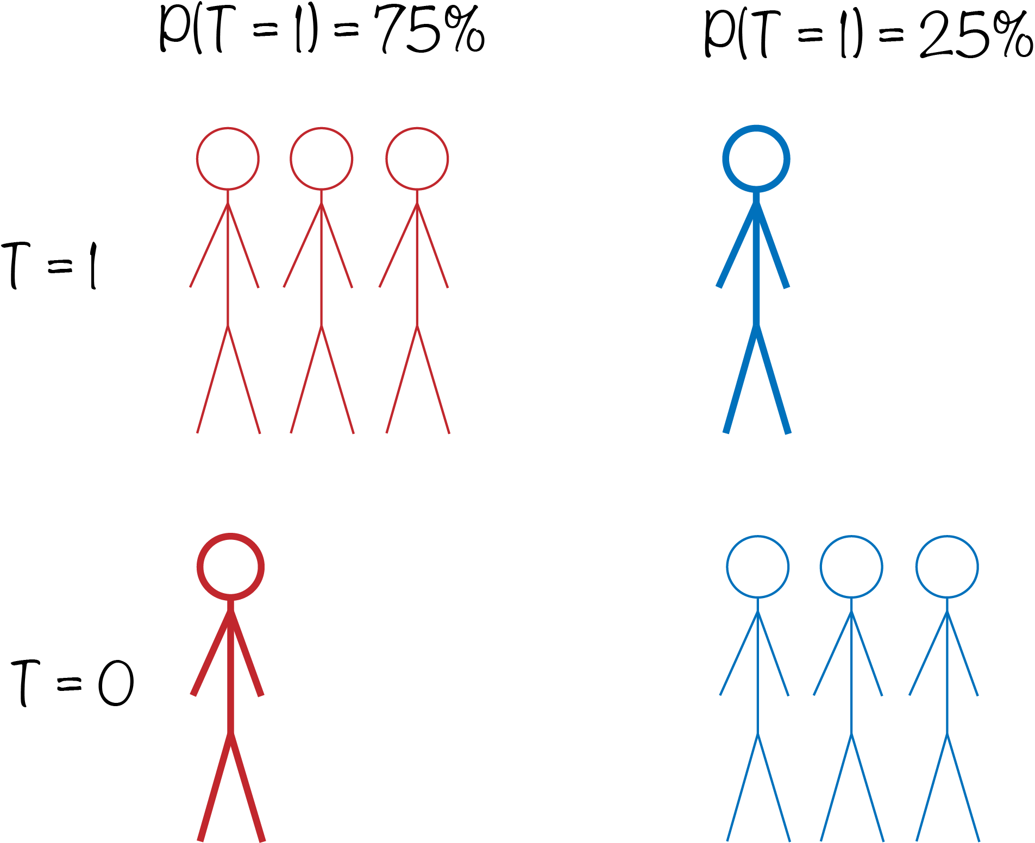

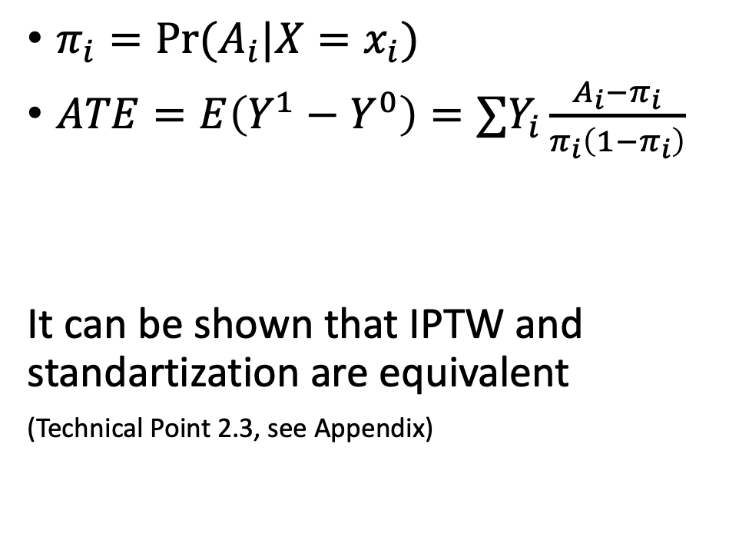
Inverse Propensity Weighting
$π_{i}=\operatorname{Pr}{(A_{i}|X=x_{i})}$
$ATE=E\left(Y^{1}−Y^{0}\right)=∑Y_{i}\frac{A_{i}−π_{i}}{π_{i}\left(1−π_{i}\right)}$
It can be shown that IPTW and standartization are equivalent
(Technical Point 2.3, see Appendix)

Slide 28
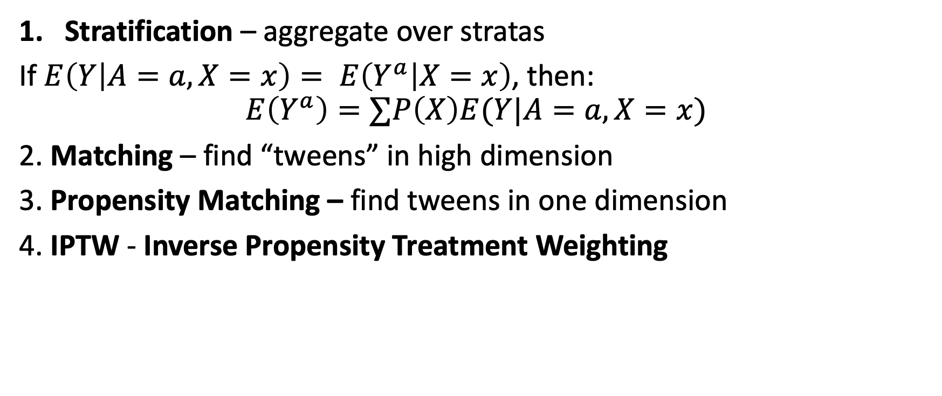
Estimation Methods
Stratification – aggregate over stratas
If $E\left(Y | A=a,X=x\right)= E\left(Y^{a} | X=x\right)$, then:
$$E\left(Y^{a}\right)=∑P\left(X\right)E(Y|A=a, X=x)$$
2. Matching – find “tweens” in high dimension
3. Propensity Matching – find tweens in one dimension
4. IPTW - Inverse Propensity Treatment Weighting

Slide 29
Better Predictions ↛ Better Effect Estimation
Which model is more accurate?
Model A is more outcome accurate
Model B is more causal accurate
“The effect of ads is positive and in small companies it is twice the effect on large one”
Notes:
https://iyarlin.github.io/2019/05/20/causal-inference-bake-off-kaggle-style/

Slide 30
Refutation (aka Model Validation)
Placebo Treatment
Replace treatment with a random variable.
Irrelevant Additional Confounder
Add a random common cause variable.
Subset validation
Remove a random subset of the data.
Random Replace
Random replace a covariate with an irrelevant variable.
Selection Bias
Blackwell, 2013

Slide 31
Application example: Uplift Modeling
E.g., Instead of predicting who will churn → predict who is most likely to reduce churn due to treatment
Steps:
Estimate CATE
Rank users according to expected effect size
The more you target the lower would be the marginal performance (diminishing return)
See CausalML

Slide 32




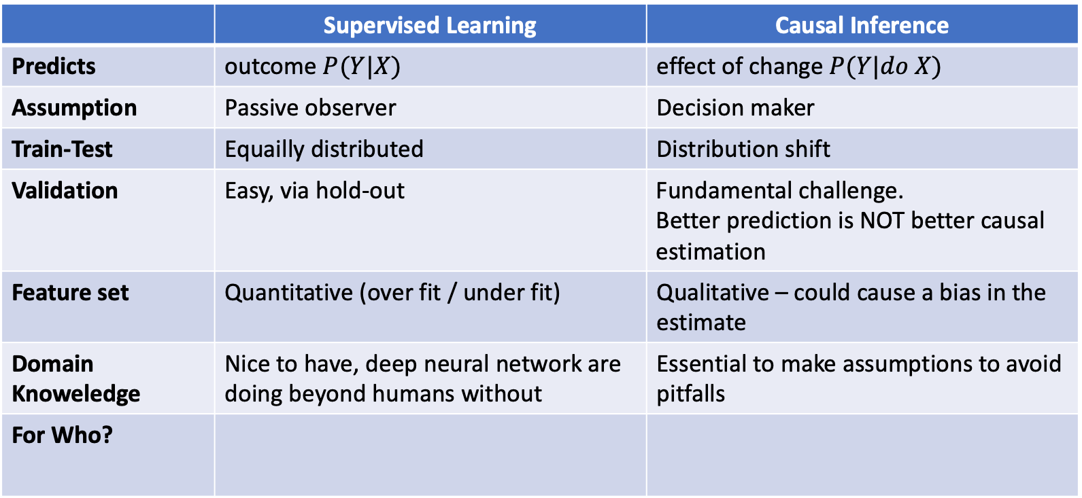
Summary – Supervised vs Causal Learning
 | Supervised Learning | Causal Inference
Predicts | outcome $P(Y|X)$ | effect of change $P(Y|do X)$
Assumption | Passive observer | Decision maker
Train-Test | Equailly distributed | Distribution shift
Validation | Easy, via hold-out | Fundamental challenge. Better prediction is NOT better causal estimation
Feature set | Quantitative (over fit / under fit) | Qualitative – could cause a bias in the estimate
Domain Knoweledge | Nice to have, deep neural network are doing beyond humans without | Essential to make assumptions to avoid pitfalls
For Who?

Slide 33

Practice
Causality in Python

Slide 34
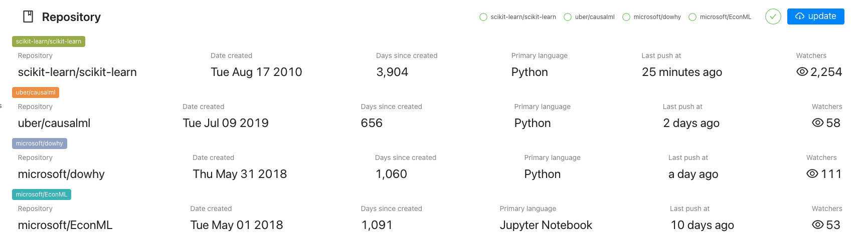
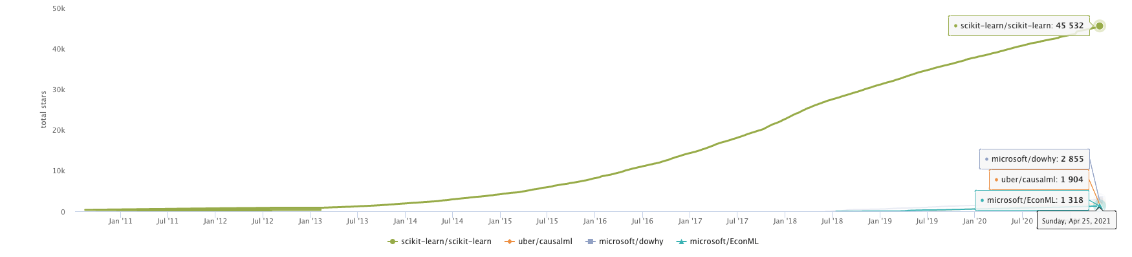
Causality in Python
https://vesoft-inc.github.io/github-statistics/
Like Scikit 10 years ago

Slide 35
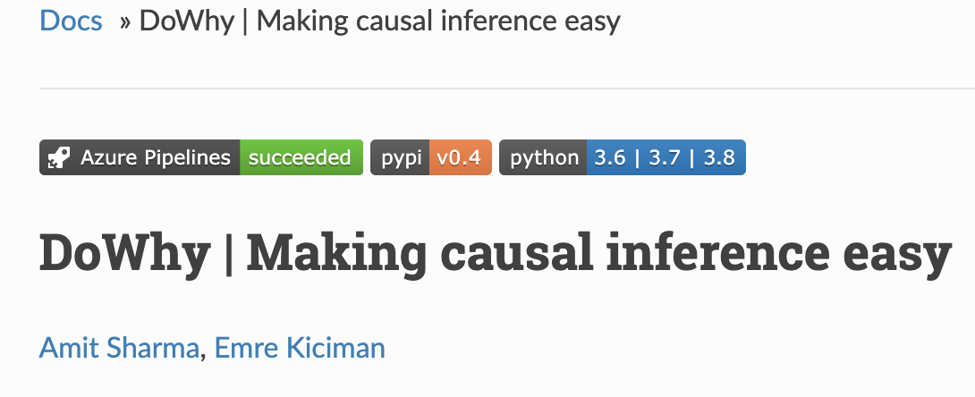
Typical Stages in a Causal Project
Model – assumptions as a graph (DAG)
If this is missing you can try causal discovery methods
Identify – turn assumptions into a list of what to control for
Estimate – use estimation methods to estimate the effect
Refute – validate and check for robustness

Slide 36

Let’s read some code

Slide 37
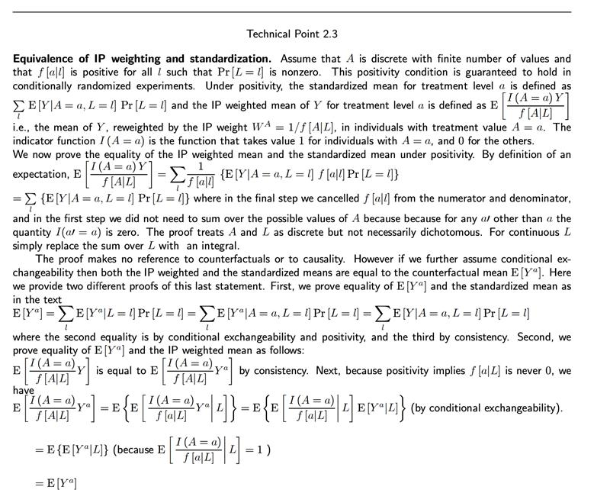
Appendix

